Slide 1
OPERATING SYSTEMS
Rr AND fcfs.
The members of the group:
1- Abdulkarim Mohammed Alasmari | 1945357.
2- Sari Abdullah Alblwi | 2142407.
3- Abdulrahman Ghazi Alabdali | 2140698.

Slide 2
Topics
RR
FCFS
Implementing

Slide 3
01 Round Robin (RR).
Round Robin Scheduling is a scheduling algorithm used by the system to schedule CPU utilization. This is a preemptive algorithm. And one of its capabilities is that there exist a fixed time slice called the quantum that is associated with each process that enters. The job scheduler saves the progress of the process that is currently being executed and moves to the next process in the queue when its time quantum is up.
There will be a switch called context switching that will make no process that will hold the CPU for a long period of time. It is probably one of the best and easiest scheduling algorithms because of its efficiency which depends on the quantum.

Slide 4
PROS AND CONS FOR Round Robin
PROS
CONS
It has low overhead for decision making.
It has equal priorities for all process unlike the rest of the algorithms because of its time quantum.
Starvation rarely occurs in this algorithm.
The efficiency of the system is decreased if the quantum value has a low value as frequent switching takes place.
If the quantum time has a high value, the system might be irresponsive.

Slide 5
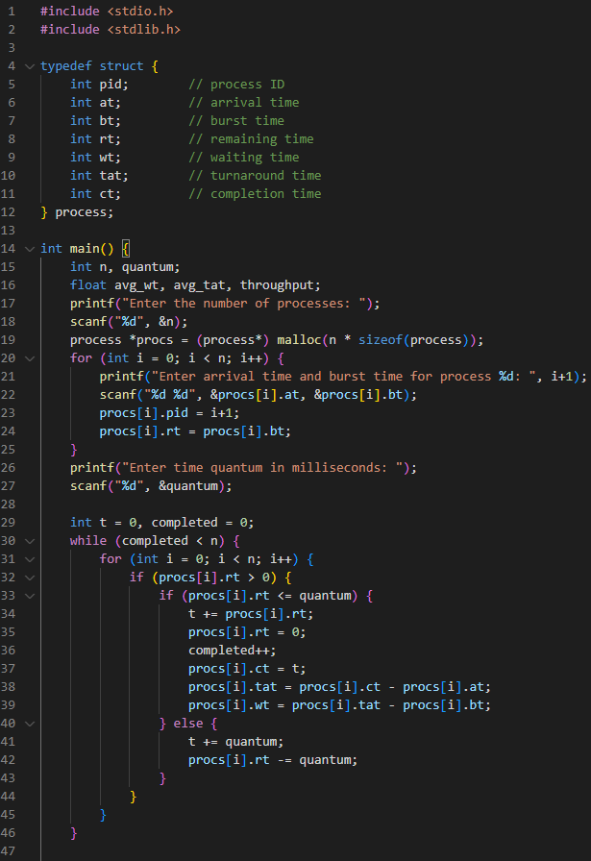
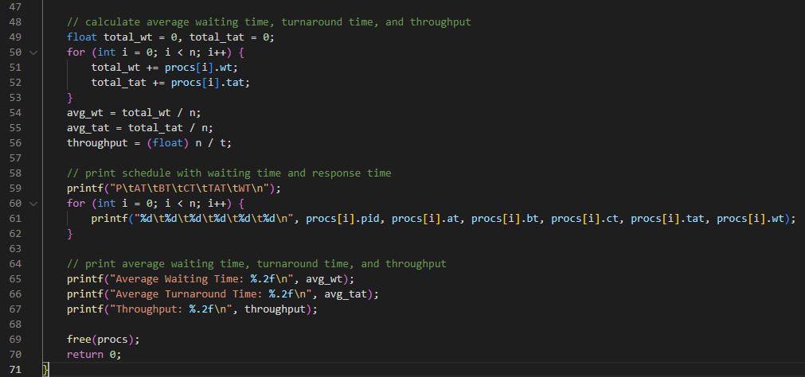
Round Robin Scheduling code

Slide 6
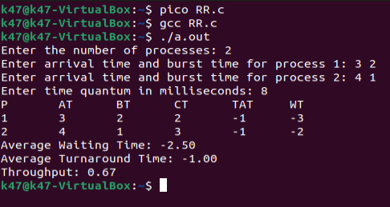
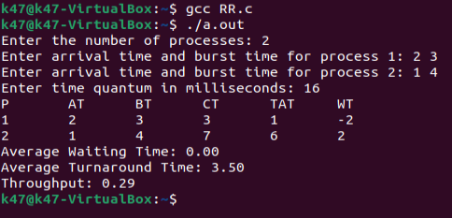
Round Robin Scheduling output examples
Quantum 8
Quantum 16

Slide 7
02 First Come First Serve (FCFS)
FCFS (First-Come-First-Serve) is a scheduling algorithm used in operating systems and other contexts.
It prioritizes tasks based on their arrival time, with the first task to arrive being processed first.
This can lead to long wait times for later-arriving tasks if earlier tasks are particularly lengthy.

Slide 8
Advantages of First Come First Serve (FCFS)
First Come First Serve algorithm has a very simple logic, it executes the process requests one by one in the sequence they arrive.
Thus, First Come First Serve is very simple and easy to understand and implement.

Slide 9
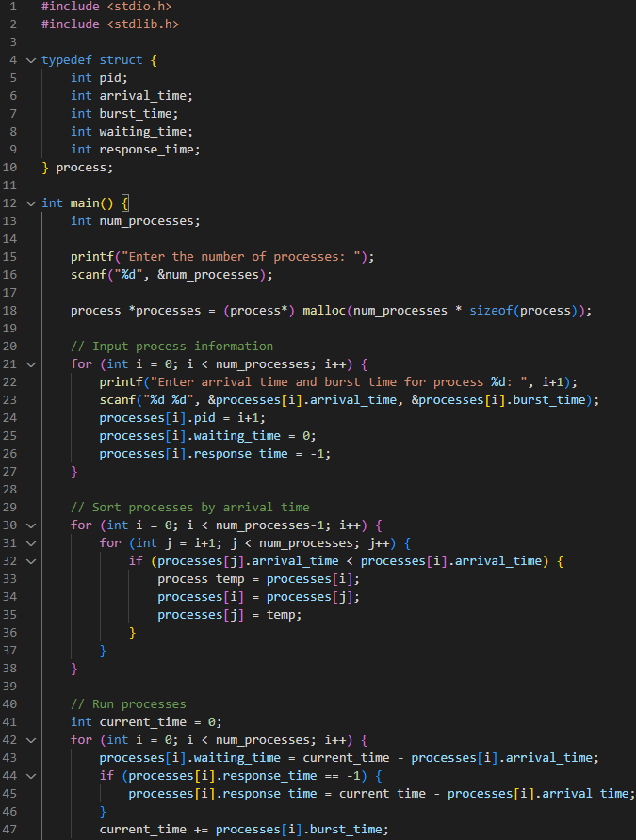
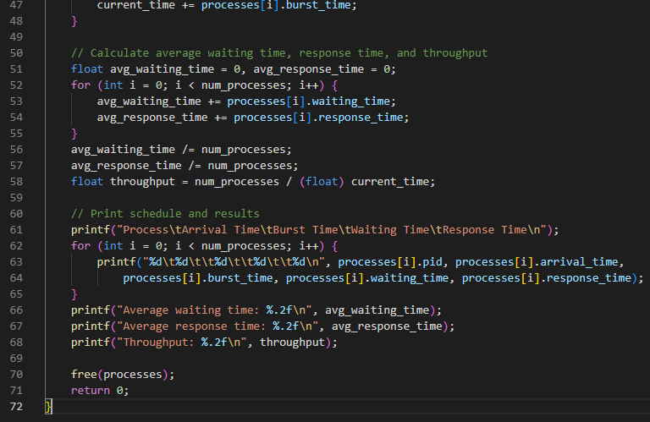
First come First served FCFS code

Slide 10
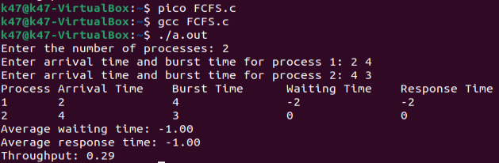
Fcfs code output

Slide 11
Task table
Task | Name
RR | 1-Abdulkarim Alasmari 2- Sari Alblwi. 3- Abdulrahman Alabdali.
FCFS | 1-Abdulkarim Alasmari 2- Sari Alblwi. 3- Abdulrahman Alabdali.
Code | 1-Abdulkarim Alasmari 2- Sari Alblwi. 3- Abdulrahman Alabdali.

Slide 12
Thank you!

